Slide 1
Naive Bayes Classifier
072BCT530

Slide 2
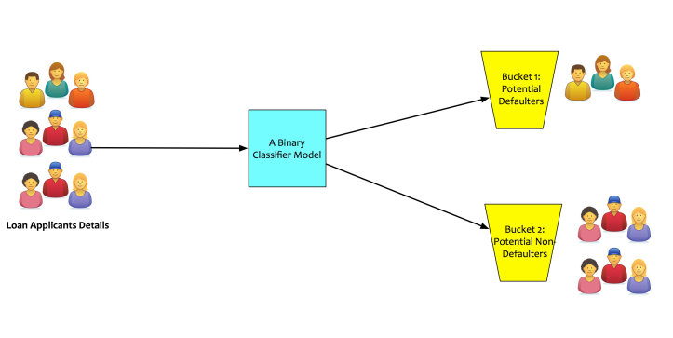
Classification

Slide 3
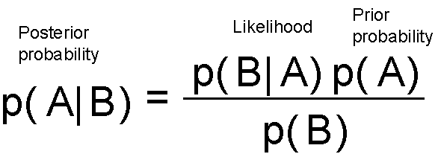
Baye’s Theorem

Slide 4

Naive Bayes
Statistical Classifier
Predicts class membership probabilities
Attribute values are independent to each other.

Slide 5
How does it work?
Find class probabilities of all classes with given feature vector.
Use Baye’s theorem to find each class probability.
One having highest probability is chosen.

Slide 6
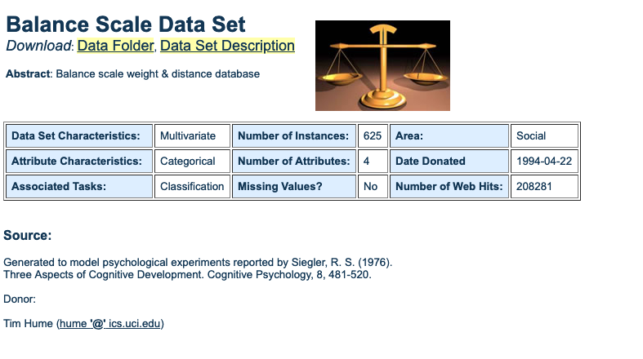
Dataset

Slide 7
Class Labels
Right
Left
Balanced

Slide 8
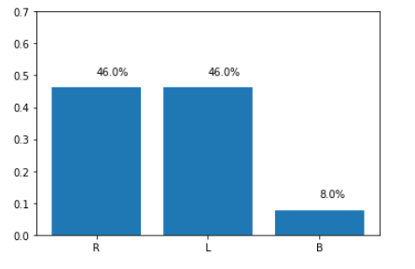
Class Distribution

Slide 9
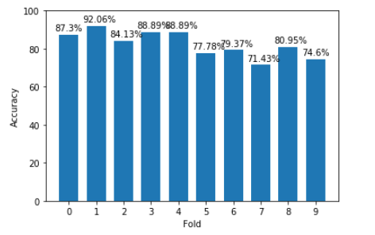
Cross Validation for 10 folds

Slide 10
Overall Average Accuracy
82.53 %

Slide 11
Thank You

